Slide 1

Mini Overture
for Brass Quintet
Witold Lutoslawski

Slide 2
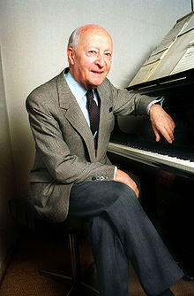
Witold Lutoslawski
January 1913 - February 1994
Early Personal Background
Polish Composer
University of Warsaw (1931 - 1937)
  Mathematics
  Piano
  Composition
WW II
  Drafted into Krakov Army
  Captured by Germans
    Escaped during the march to the concentration camp
    Ran 250 miles back to Warsaw
  Later escaped the Warsaw Uprising losing most of his music and scores to the German invasion
Soviet Influence (Stalin)
  Considered a “formalist” and was shunned
  Forced to write music considered acceptable

Slide 3
Pertinent Compositional Influences
Folk, Serialism, Aleatory
Folk Influence
Heavy Influence of Polish Folk Music
  using deconstruction techniques most melodies and harmonies are unrecognizable
Serialism
The Lutoslawski Tone Row
  Based on melodies and harmonies of specific intervals for that specific composition
  Dense chords vs. Tone clusters
  Different in conception than the Schoenberg 12-tone row
Symphony No. 1
Paganini Variations
Muzyka zalobna
Aleatory technique: Left to chance and/or the determination of the performer.
Indeterminacy
  The ability of a piece to be performed in substantially different ways
John Cage influence
String Quartet (1964)
Three Postludes
Jeux venitiens
Other Works for Brass:
CUBE Fanfare for brass (1987)
Fanfare for the Los Angeles Philharmonic (1993)

Slide 4
Mini Overture for Brass Quintet
1982
“Small Caricature of an Overture”
Neoclassical aesthetic of the scherzo
Idioms similar to Stravinsky’s L’histoire du soldat
Sonata form outlined by two 12-tone series
Non Aleatoric (rare at this time)
Dedication
Dedicated to Walter Strebi who is the father of Ursula Jones, wife of Philip Jones, leader of the internationally renowned Philip Jones Brass Ensemble who premiered the work in Lucerne Switzerland.
Chamber Series
The commission was part of a larger chamber series conceived but Witold and Walter
Epitaph for oboe and piano
Mini Overture
Subito for violin and piano

Slide 5
The Presentation
Lutoslawski 12-tone techniques
  The Aggregate
    Measure Encapsulated/Chromatic Lines/12-tone blocks
    Discrete trichords and tetrachords
      The Minor Tetramirror
    Melodic Tone Row
Chaos to order - Alternate Compositional Methods
  Cascading attacks
  Rhythm – Propelling Trichords
  Tonality – Centricity/Polytonality
  Form: A B A’ B’ C A’’ C’ A coda
Popular Recordings
Gwandhaus Brass Quintet/Meridian Arts Ensemble
Stockholm Chamber Brass
Where to Purchase
  www.jwpepper.com
  www.sheetmusicplus.com

Slide 6
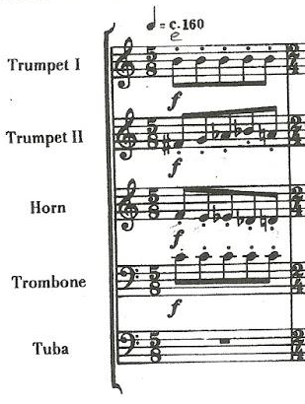

The Aggregate
Consider this: The Universe
Lutoslawski wastes no time in announcing his first 12-tone technique,
The Aggregate
All 12 tones are played in the first measure of the piece with Trumpet 2 and the Horn providing a direction by use of the chromatic wedge. Although not a mirrored wedge, all chromatic tones are played.
This ‘measure encapsulated aggregate’ happens several times throughout the piece...
.

Slide 7
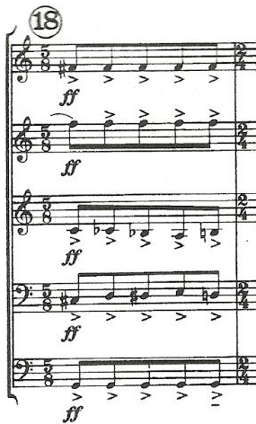
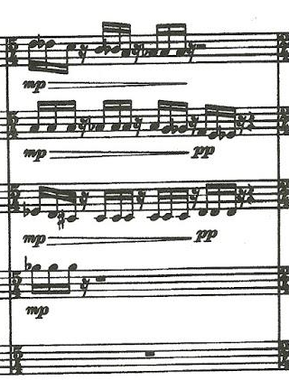
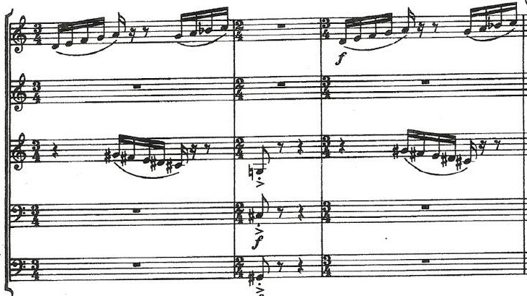
The Aggregate
Measure Encapsulated
The aggregate to the left begins the recap
The measure to the left shows a measure encapsulated aggregate using several 3-note chromatic blocks – a [012] in P.T. speak
.
The first and third measures to the right also indicate a measure encapsulated aggregate (sans pc e – B-natural)

Slide 8
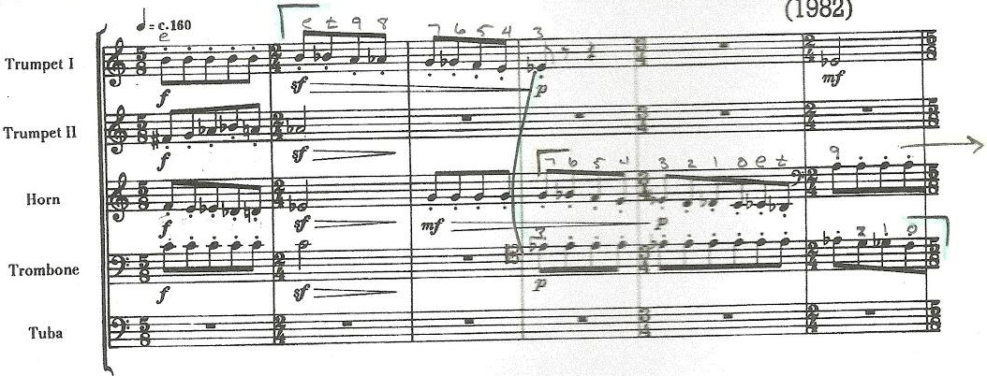
The Aggregate
Chromatic Lines:
WL uses chromaticism widely throughout the tune. These next few examples highlight his use of the chromaticism of all 12 tones as a melodic element. This particular example at the very beginning of the tune.
.

Slide 9
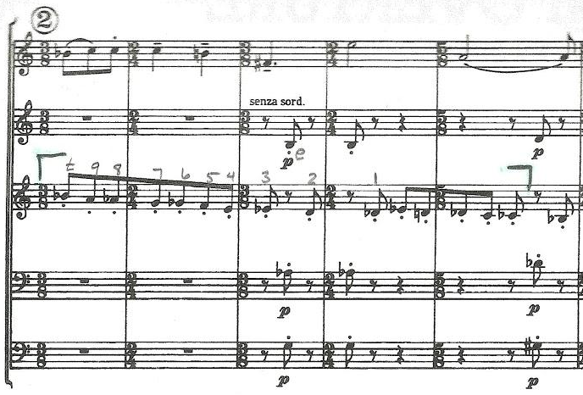
The Aggregate
Chromatic Lines
The horn takes the line (with help from Tpt II). This is occurring the 12 tone row melody in the Tpt I part (discussed later). Pay attention to how the ear is drawn to the melody with underlying chromaticism

Slide 10
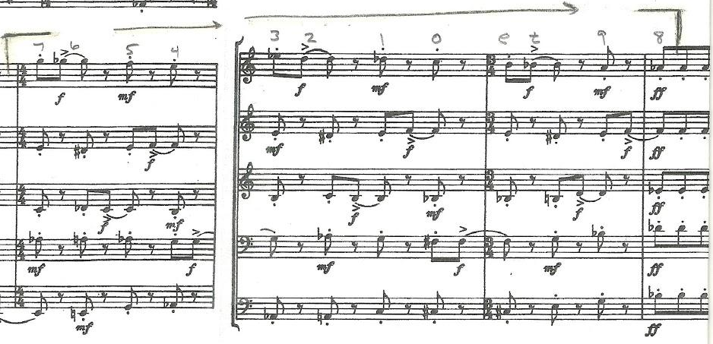
The Aggregate
Chromatic Lines
The chromatic line (below - Tpt I) is the same as the chromatic line presented in the horn from the very beginning of the piece but the composer purposfully hides that line by inserting articulate interruptions in the other instruments

Slide 11
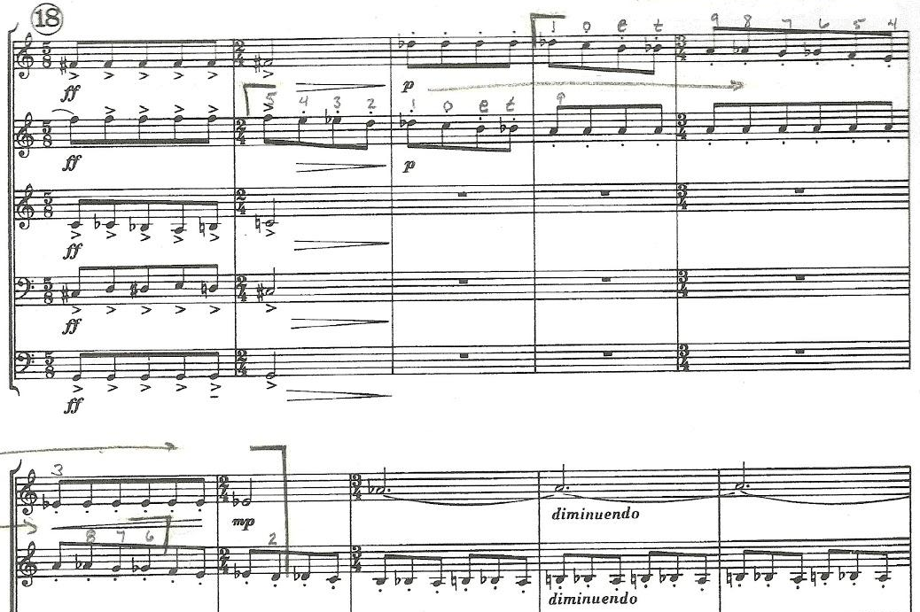
The Aggregate
Chromatic Lines

Slide 12
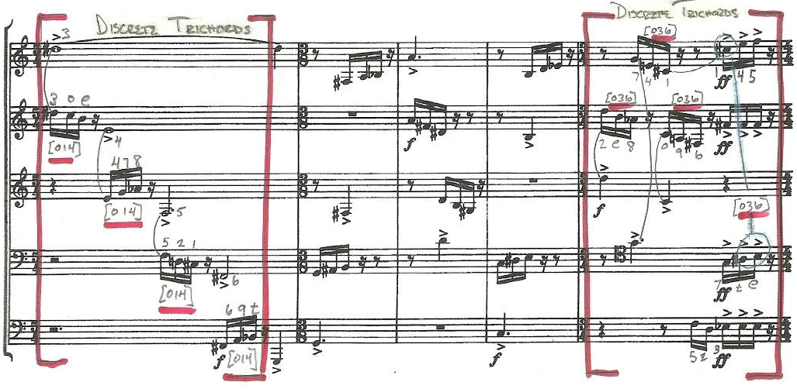
The Aggregate
Discrete Trichords – a trichord is a group of 3 different pitch classes (notes)
These happen to be ‘measure encapsulated’ Discrete Trichords. You will also notice the propelling rhythm and cascading harmonies (blue)
DISCRETE TRICHORDS
DISCRETE TRICHORDS

Slide 13
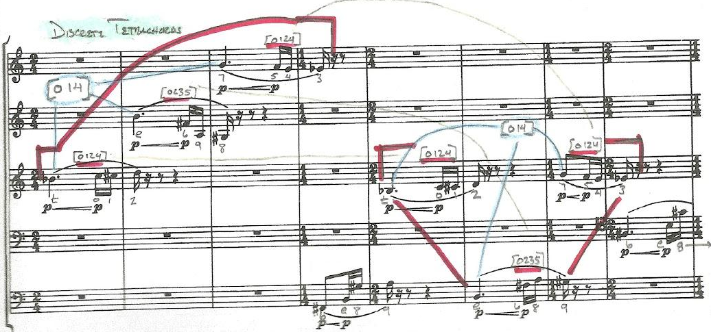
The Aggregate
Discrete Tetrachords – a tetra chord is a group of 4 different pitch classes (notes)
These tetrachords are used in different order (indicated by yellow) throughout the tune. The example below is one example.
.
DISCRETE TRICHORDS
DISCRETE TETRACHORDS
[014]
DISCRETE TETRACHORDS
[014]
[0235]
[0235]
[0235]

Slide 14
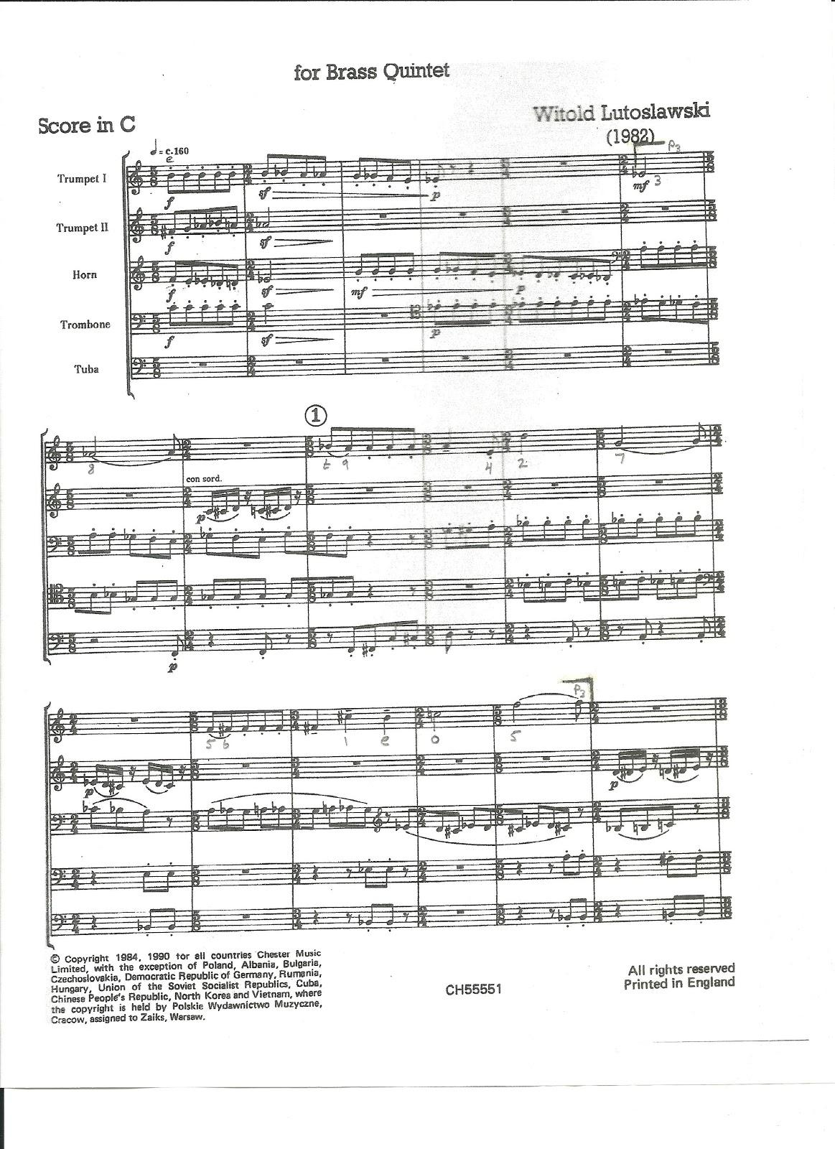
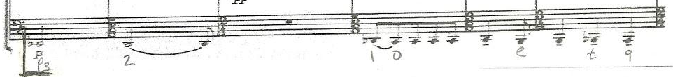
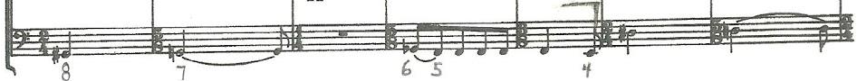
The Aggregate
The Melody {3 8 t 9 4 2 7 (5) 6 1 e 0 (5)}
.
Trumpet I
Tuba {3 2 1 0 e t 9 8 7 6 5}

Slide 15
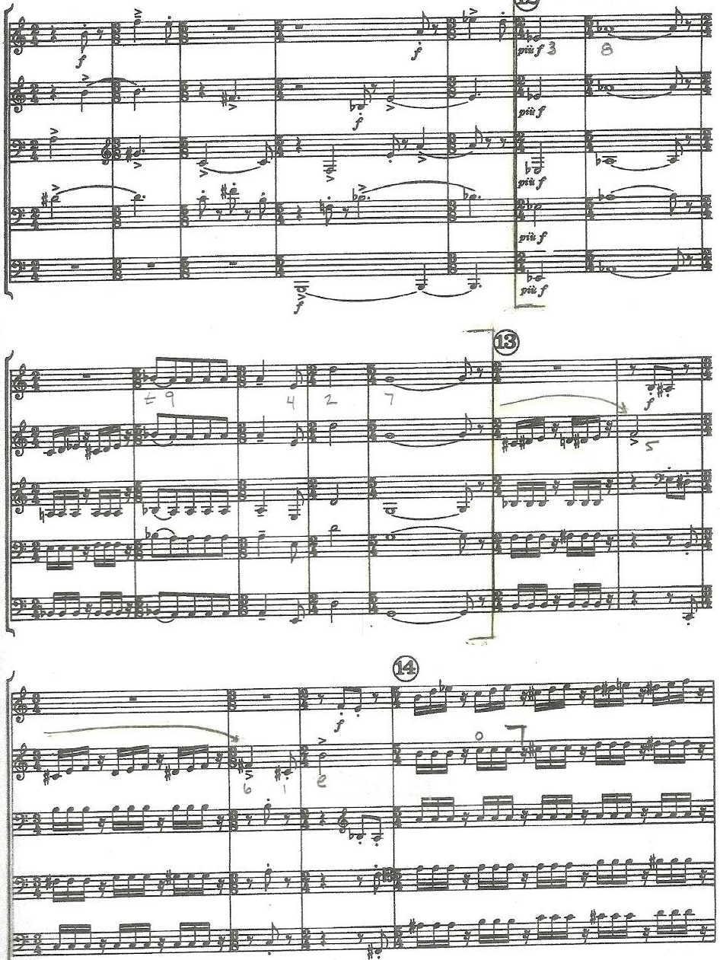
The Aggregate
Melody Restatement
{3 8 t 9 4 2 7 (5) 6 1 e 0 (5)}
.

Slide 16
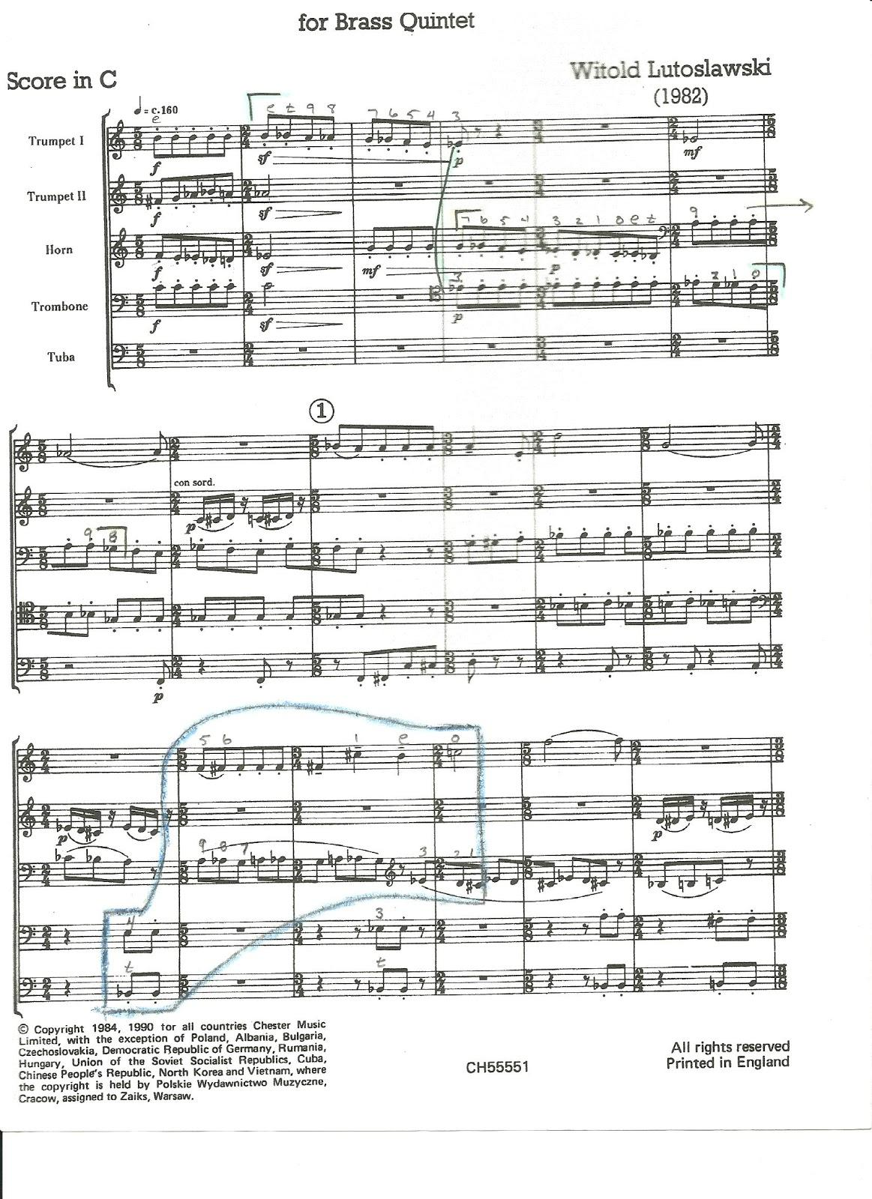
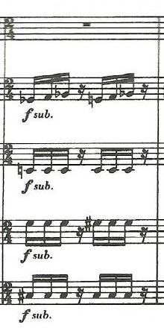
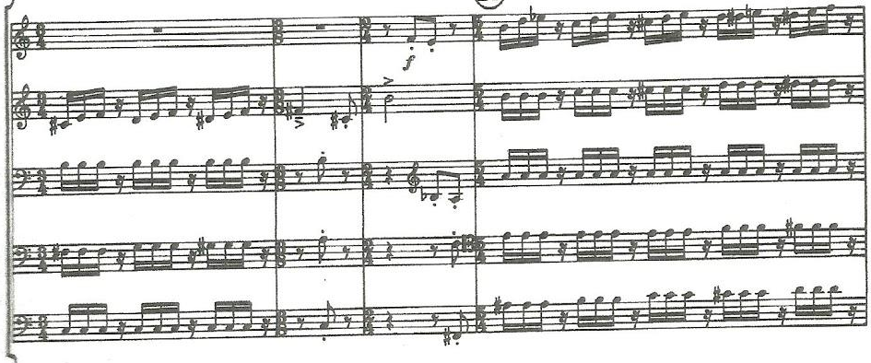
Propelling Trichords
[012], [013], [014]
Sudden Interruptions
[013] - [012]
Light Interjections
[012] ascending and descending
[013]
[012]
Propelling Anticipation
[014], [013], [012]
[014]
[013]
[012]
[014]
[013]
[012]

Slide 17
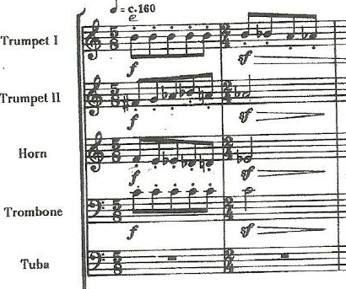
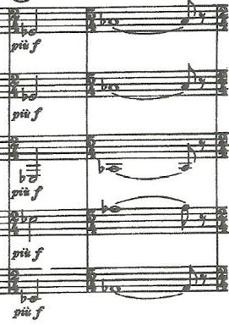
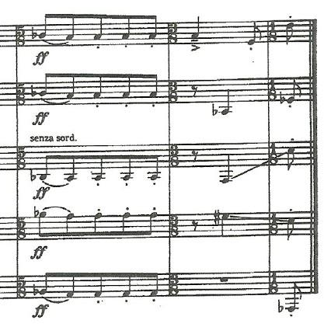
Tonality
Ab Centricity

Slide 18
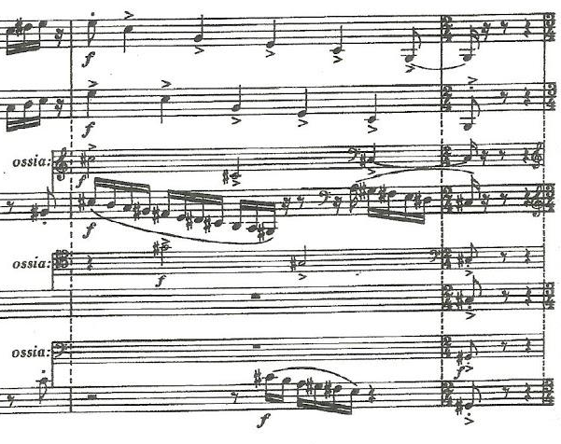
Tonality
Polytonal
C Major
C# Minor

Slide 19
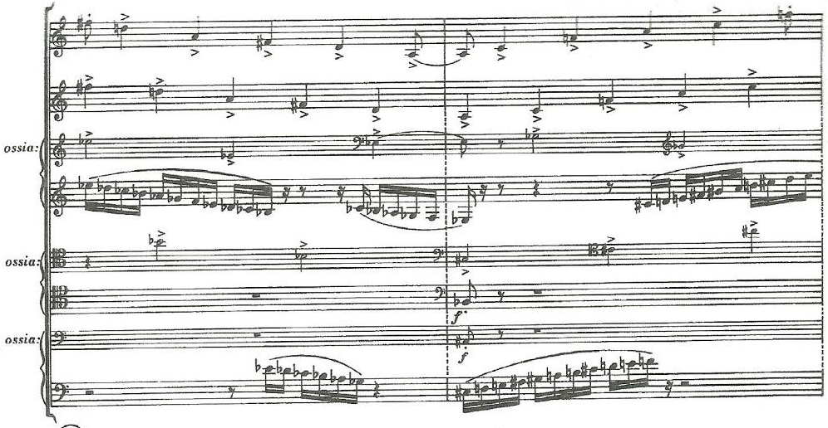
Tonality
Polytonal
Trumpets: D Major
Hrn, Tbn, Tba: eb Minor
Trumpets: F Major
Hrn, Tbn, Tba: A Major

Slide 20
Popular Recordings
Gewandhaus Brass Quintet
Played ‘thoughtfully’ – more attention to the melodic line and note quality, especially muted sounds
https://open.spotify.com/track/2pXlIst8VaDV6bthW6uf7K
Stockholm Chamber Brass
Faster Recording – more attention on attacks, weight, and brighter tone color
https://open.spotify.com/track/5dX9e6ImP9sytELsbAVZIH
Meridian Arts Ensembles
Fastest Recording – more attention on rhythmic drive and cleanliness
https://open.spotify.com/track/7kKILxcsRZfan9ABTVWJq7

Slide 21
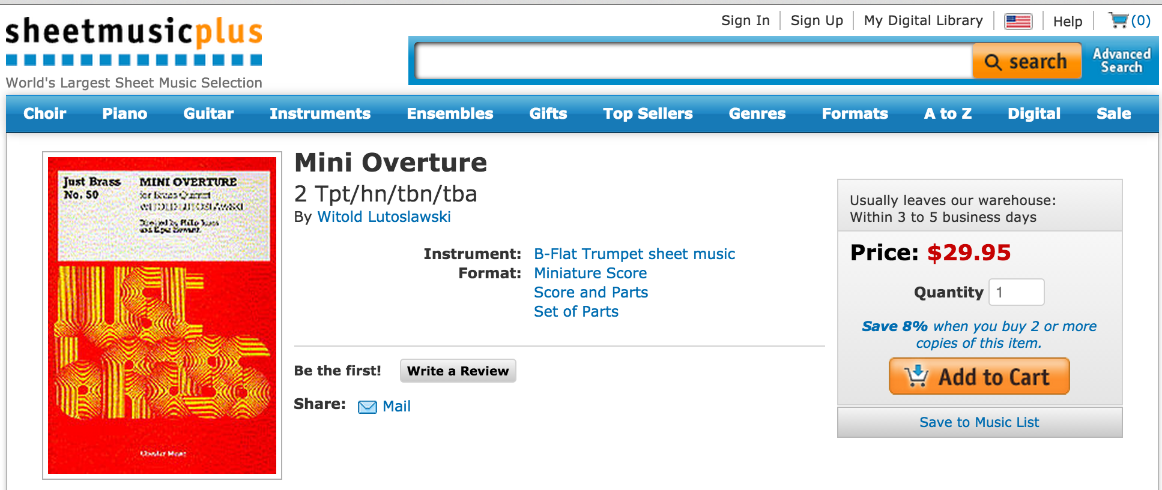
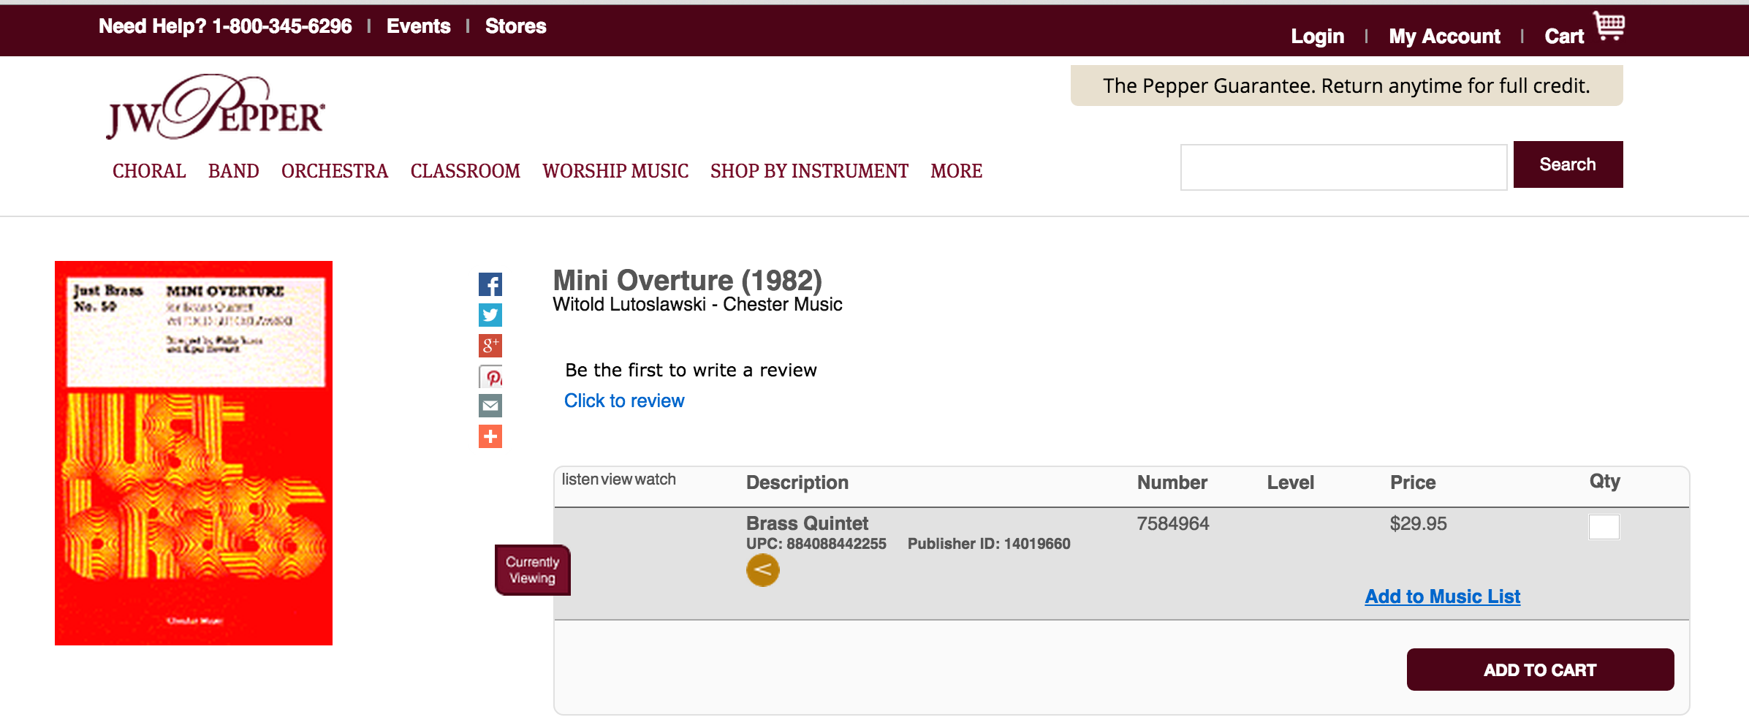
Where to Purchase
www.sheetmusicplus.com
www.jwpepper.com

